Slide 1

STOCK MARKET PREDICTION
Pradeep Kumar Kolisetty (0734185)
Sanjana Reddy Patlolla (0736615)
Sai Prudvi Adusumalli (0734178)

Slide 2
INTRODUCTION
Stock market is the largest area in the society where the buying and selling activities take place. The stock value in the market changes each day and by observing that the trading that is the buying and selling happens. The price change in the stocks can happen due to many factors such as weather changes, political consequences.

Slide 3
PROBLEM STATEMENT
Stock market prediction determines the company’s future by taking the historical data into consideration, make predictions of the crashes that’s going to occur and minimize the Investor’s losses.
By observing the past data, we predict the rise and fall of the stocks and help the investors to know where to invest. It majorly includes the company performance in the recent years based on factors such as political consequences and climate changes.

Slide 4
Data Insights
Dataset of our project,” Stock market prediction” is extracted from NASDAQ (National Association of Securities Dealers Automated Quotations) website.
Data consist of 7 columns of data which is date , close/last , open, High, Low, volume, Company columns.
There are 22000 rows of data of 10 companies amazon, apple, Facebook, zygan, AMD, Starbucks, Tesla, Microsoft, Qualcomm, Cisco System. The data is of 10 years.

Slide 5
Data Insights
Close/last and open price explains the price of the stocks before the end of the day and start of the next day.
Volume column explains the number of shares that changed hands during a given day.
High, low columns in the context of stocks means the highest and lowest prices of a stock recorded on a given day.

Slide 6
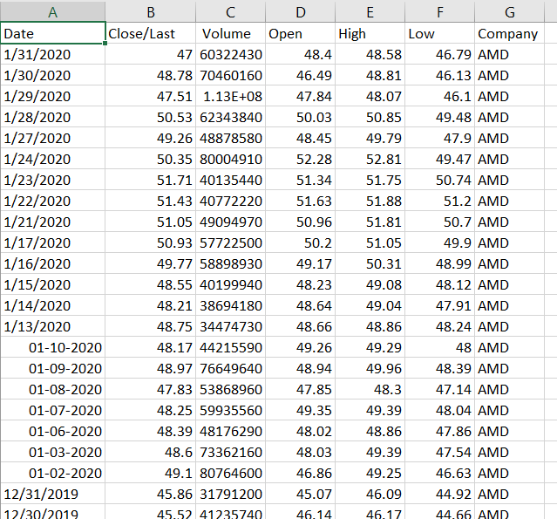
Data View

Slide 7
MODELS
We use Neural network ,structural support vector machine (SSVM), support vector machine (SVM) models to work on the data.
We are going NLP package to simplify the text pre-processing and we can focus on using the machine learning models to use on the data.

Slide 8
NLP
Natural language processing (NLP) is the ability of a computer program to understand human language as it is spoken. NLP is a component of artificial intelligence (AI).
Natural language processing or NLP for short is used to analyse text and let machines derive meaning from the input.

Slide 9




ETHICAL PRINCIPLES
1.Consent.
2.Clarity.
3.Control.
4.Consistency.
5.Consequences.

Slide 10
OUTCOMES ACCESSED
Future scope of this project will involve adding more parameters and factors like the financial ratios, multiple instances, etc. The more the parameters are taken into account more will be the accuracy
By using the machine learning models on the data, we can observe the stocks on which day and which factors are affecting the stocks and, in the future, we can prevent them to avoid the losses. We can predict the crashes by analysing different weather and political consequences.

Slide 11
PROGRESS
Selecting a topic
Collecting data
Presenting the problem statement
Data cleaning

Slide 12
REFERENCES
Yordanov, V. (2019, August 13). Introduction to Natural Language Processing for Text. Retrieved from https://towardsdatascience.com/introduction-to-natural-language-processing-for-text-df845750fb63.
Natural Language Processing for Text
Introduction to Natural Language Processing for Text. (2019). Retrieved 18 February 2020, from https://towardsdatascience.com/introduction-to-natural-language-processing-for-text-df845750fb63
Historical Data. (n.d.). Retrieved from https://www.nasdaq.com/market-activity/quotes/historical

Slide 13

THANKYOU

